Slide 1
Spark on HDInsight Spark Streaming
Ali Zaidi
Data Scientist
Machine Learning Education Team

Slide 2

Learning objectives
Introduction to Spark Streaming
DStream
Windowing
Guarantees
Stream processing

Slide 3
Introduction to Spark Streaming

Slide 4

What is Spark Streaming?
Spark Streaming is an extension of the core Spark API that enables high-throughput, fault-tolerant stream processing of live data streams.
Kafka
Flume
HDFS
ZeroMQ
Twitter
Spark
streaming
HDFS
Databases
Dashboards
Notes:
Objective: This slide describes the solutions that Spark Streaming offers.
Talking points:
Ingests data from many sources, including Kafka, Flume, Twitter, ZeroMQ, and TCP sockets.
Processes events using complex algorithms expressed with high-level functions like map, reduce, join, and window.
Pushes processed data out to filesystems, databases, and live dashboards.
Applies the machine learning algorithms of Spark and graph-processing algorithms on data stream.

Slide 5
DStream

Slide 6
How it works
Discretized streams (DStreams)
Callback functions
Input data stream
Batches of input data
Batches of processed data
Spark Streaming
Spark engine
Notes:
Objective: This slide describes how Spark Streaming “divides and conquers” big data into data streams.
Talking points:
DStreams, also known as discretized streams, is when Spark Streaming receives live input data streams and divides them into mini-batches.
The DStreams are then processed by the Spark engine to generate the final stream of results in batches.
To develop a Spark Streaming application, implement a callback function that is invoked for every DStream.
The callback function can apply DStream-specific “transformations” on the incoming DStreams.
This is how the streaming solution flows:
Create an Azure Event Hub that will receive a stream of events.
Run a local standalone application that generates events and pushes it the Azure Event Hub. The sample application that does this is published at https://github.com/hdinsight/spark-streaming-data-persistence-examples.
Run a streaming application remotely on a Spark cluster that reads streaming events from Azure Event Hub and pushes it out to different locations (Azure Blob, Hive table, and SQL Database table).

Slide 7
Core abstraction: DStream
DStream is the basic abstraction provided by Spark Streaming
Immutable, partitioned, and fault-tolerant
Represented by a continuous sequence of RDD
DStream
RDD
RDD
RDD
Data from Time T0 to T1
Data from Time T1 to T2
Data from Time T2 to T3
Notes:
Objective: This slide describes the core values and concept of DStream.
Talking points:
DStream is the basic abstraction provided by Spark Streaming.
It is immutable, partitioned, and fault-tolerant.
Internally, it is represented by a continuous sequence of RDD. Each RDD in a DStream contains data from a certain interval.
Any operations applied on a DStream translate to operations on the underlying RDDs. The Spark engine computes these underlying RDD operations, and DStream operations hide most of the details and provide the developer with a higher-level API for convenience.
You can configure the size of the batch that determines the “width” of the DStream.

Slide 8
DStream operations
Two kinds of DStream operations: transformations and output
Similar to RDD transformations, DStream transformations operate on one or more DStreams to create new DStreams with transformed data .
Output operations write data out to an external data sink, such as a filesystem or a database
Notes:
Objective: This slide describes the core values and concept of DStream.
Talking points:
Two kinds of DStreams operations: transformations and output.
Similar to RDD transformations, DStream transformations operate on one or more DStreams to create new DStreams with transformed data.
Examples: map(), flatmap(), repartition(), join(), union(), count(), and upDateStateBykey()
Output operations write data out to an external data sink, such as a filesystem or a database.
Examples: print(), foreachRDD(), saveAsObjectFiles(), saveAsTextFiles(), and saveAsHadoopFiles()

Slide 9
Sample code
// StreamingContext is the main entry point for all streaming functionality
// First, create a StreamingContext with a local master
val ssc = new StreamingContext("local", "NetworkWordCount", Seconds(1))
// Create a DStream that will connect to serverIP:serverPort, like localhost:9999
val lines = ssc.socketTextStream("localhost", 9999)
// Split each line into words using the flatMap function
val words = lines.flatMap(_.split(" "))
// Count each word in each batch val pairs = words.map(word => (word, 1)) val wordCounts = pairs.reduceByKey(_ + _) wordCounts.print()
// When these lines are executed, Spark Streaming sets up computation // Processing starts when the following calls are made:
ssc.start() // Start the computation ssc.awaitTermination() // Wait for the computation to terminate
Notes:
Objective: This slide represents various ways to implement DStream in data to better organize and understand your batch.
Talking points:
This Scala program prints out the frequency of words in an incoming text stream.
The streams form a socket input and prints the result to the console.
Note that the program counts the frequency for each batch.
flatMap is similar to map, but each input item can be mapped to zero or more output items.
The program runs “forever waiting” for input until terminated.

Slide 10
Windowing

Slide 11
Windowing in Spark
Spark provides a set of transformations that apply to a sliding window of data.
A window is defined by two parameters: window length and slide interval.
First 8 sec. window
Second 8 sec. window
1
2
3
4
5
6
7
8
9
10
11
12
Secs.
Window operation is performed here.
Window operation is performed here, 4 seconds after the previous one.
“Tumbling window” effect can be achieved by making slide interval = window length
Notes:
Objective: This slide shows a set of transformations used in Apache Spark that encompasses windowing.
Talking points:
A window is defined by two parameters:
Window length: the duration of the window
Slide interval: the interval at which the window-based operation is performed
The figure shown displays a window with a length equaling 8 secs. and slide interval equaling 4 secs.

Slide 12
Spark: Window transformation operations
Transformation | Meaning
Window (windowLength, slideInterval) | Returns a new DStream that is computed based on windowed batches of the source DStream.
countByWindow (windowLength, slideInterval) | Returns a sliding window count of elements in the stream.
reduceByWindow (func, windowLength, slideInterval) | Returns a new single-element stream, created by aggregating elements in the stream over a sliding interval using func. The function should be associative so that it can be computed correctly in parallel.
reduceByKeyAndWindow (func, windowLength, slideInterval, [numTasks]) | When called on, a DStream of (K, V) pairs returns a new DStream of (K, V) pairs, where the values for each key are aggregated using the given reduce function (func) over batches in a sliding window.
reduceByKeyAndWindow (func, invFunc, windowLength, slideInterval, [numTasks]) | A more efficient version of the above reduceByKeyAndWindow(), where the reduce value of each window is calculated incrementally, using the reduce values of the previous window. This is done by reducing the new data that enters the sliding window, and "inverse reducing" the old data that leaves the window. An example would be that of "adding" and "subtracting" counts of keys as the window slides. However, it is applicable to only "invertible reduce functions”—that is, those reduce functions that have a corresponding "inverse reduce" function (taken as parameter invFunc).
countByValueAndWindow (windowLength, slideInterval, [numTasks]) | When called on, a DStream of (K, V) pairs returns a new DStream of (K, Long) pairs where the value of each key is its frequency within a sliding window.
Notes:
Objective: This slide displays the different type of transformations used to perform windowing.
Talking points:
Window (windowLength, slideInterval) – Returns a new DStream that is computed based on windowed batches of the source DStream.
countByWindow (windowLength,slideInterval) – Returns a sliding window count of elements in the stream.
reduceByWindow (func, windowLength,slideInterval) – Returns a new single-element stream, created by aggregating elements in the stream over a sliding interval using func. The function should be associative so that it can be computed correctly in parallel.
reduceByKeyAndWindow (func,windowLength, slideInterval, [numTasks]) – When called on, a DStream of (K, V) pairs returns a new DStream of (K, V) pairs, where the values for each key are aggregated using the given reduce function (func) over batches in a sliding window.
reduceByKeyAndWindow (func, invFunc,windowLength, slideInterval, [numTasks]) – A more efficient version of the above reduceByKeyAndWindow(), where the reduce value of each window is calculated incrementally, using the reduce values of the previous window. This is done by reducing the new data that enters the sliding window, and "inverse reducing" the old data that leaves the window. An example would be that of "adding" and "subtracting" counts of keys as the window slides. However, it is applicable to only "invertible reduce functions”—that is, those reduce functions that have a corresponding "inverse reduce" function (taken as parameter invFunc).
countByValueAndWindow (windowLength,slideInterval, [numTasks]) – When called on, a DStream of (K, V) pairs, returns a new DStream of (K, Long) pairs where the value of each key is its frequency within a sliding window.

Slide 13
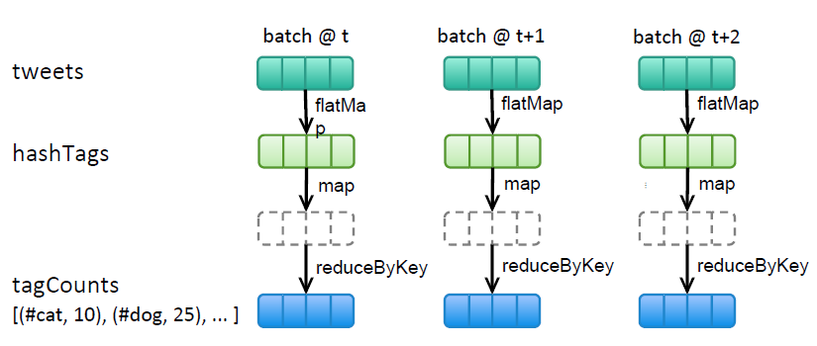
Windowing sample code
Count hashtags in a Twitter stream over the last 10 mins., and update every 2 secs.
val tweets = ssc.twitterStream<Twitter username>, <Twitter password>)
val hashTags = tweets.flatMap (status => getTags(status))
val tagCounts = hashTags.window(Minutes(10), Second(2)) countByValue()
Window operation
Window length
Sliding interval
Callback operation
countByValue() is invoked every 2 secs. All RDDs accumulated in the previous 10 minutes are passed to the callback function.
Notes:
Objective: In this example, you can count the hashtags found in a Twitter stream over the last 10 minutes and update it every two seconds.
Talking points:
Once you’ve defined the three types of values you have (tweets, hashtags, and count of tags), you can construct code to perform the operation you’ve written. This will encompass a window operation, window length, sliding interval, and callback operation.

Slide 14
Guarantees

Slide 15
“Exactly once,” “At least once,” guarantees
1
Spark provides both exactly once and at least once guarantees.
DStreams are fault-tolerant.
DStreams can be recomputed from an input data source using the lineage, assuming input data is still available to be recomputed.
Notes:
Objective: This slide outlines what type of guarantees you can use in your DStream.
Talking points:
Spark provides both exactly once and at least once guarantees.
DStreams, like RDDs, are fault-tolerant and can be recomputed from an input data source using the lineage.
However, it assumes that the input data is still available to be recomputed. It works if the data source itself is fault-tolerant and persistent (HDFS, Kafka).
If the data stream is delivered over a network (socket stream), then the default persistence behavior of Spark replicates data to two worker nodes. Any data received by a node but not yet replicated might be lost when the receiving node fails.
The application developer is responsible for ensuring exactly once behavior for external updates (such as storing intermediate state in a database). Spark provides no support.

Slide 16
Stream processing

Slide 17







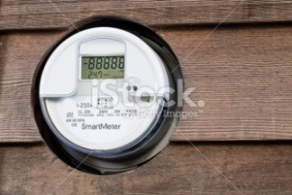
Stream processing
Analyzing events in-flight, as they are streaming.
Use cases from stream processing:
Network monitoring
Intelligence and surveillance
Fraud detection and risk management
E-commerce
Smart order routing
Transaction cost analysis
Pricing and analytics
Algorithmic trading
Data warehouse augmentation
Notes:
Objective: This slide emphasizes the importance of getting data in-flight or “streaming” rather than getting data once it has been stored.
Talking points:
Data can lose much of its value if it’s not analyzed within milliseconds (or seconds) of being generated.
Examples: stock tickers, twitter streams, device events, and network signals.
Stream processing is about analyzing events in-flight, as they are streaming, rather than when they are stored in a database.
Use cases from stream processing:
Network monitoring
Intelligence and surveillance
Fraud detection and risk management
E-commerce
Smart order routing
Transaction cost analysis
Pricing and analytics
Algorithmic trading
Data warehouse augmentation

Slide 18
Demo
Scala application to send messages to Event Hub and Update the Scala streaming application for receiving the events
Notes:
Sources:
What’s Up with Spark – Spark Streaming (Channel 9)
https://channel9.msdn.com/Series/Azure-Data-Lake/Whats-up-with-Spark55-Spark-Streaming
Microsoft Azure – Spark Streaming: Create an Events Hub
https://azure.microsoft.com/en-us/documentation/articles/hdinsight-apache-spark-eventhub-streaming/
Microsoft Azure – Spark Streaming: Use a Scala application to send messages to Event Hub
https://azure.microsoft.com/en-us/documentation/articles/hdinsight-apache-spark-eventhub-streaming/
Microsoft Azure – Spark Streaming: Run the applications remotely on a Spark cluster using Livy
https://azure.microsoft.com/en-us/documentation/articles/hdinsight-apache-spark-eventhub-streaming/
Microsoft Azure – Spark Streaming: Update the Scala streaming application for receiving the events
https://azure.microsoft.com/en-us/documentation/articles/hdinsight-apache-spark-eventhub-streaming/
Apache Spark – Spark Core/Streaming: Running the Examples and Shell - A Quick Example: Scala
https://spark.apache.org/docs/1.5.1/streaming-programming-guide.html#a-quick-example
Github – Spark Streaming Examples
https://github.com/hdinsight/spark-streaming-data-persistence-examples

Slide 19
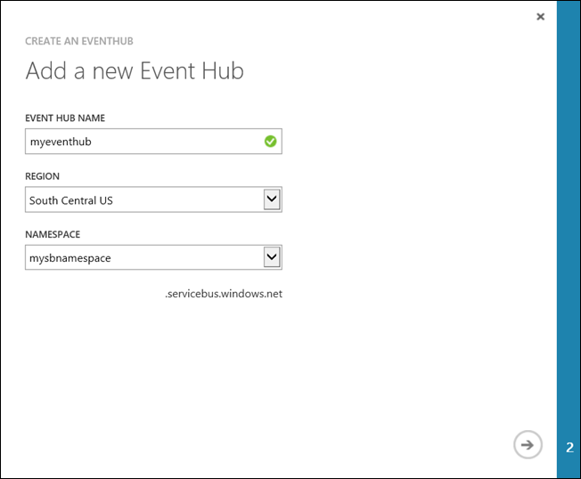
Notes:
Objective: This slide begins a demo showing how to use a Scala application to send messages to Event Hub and update the Scala streaming application for receiving the events.
Talking points:
This is how the streaming solution flows:
Create an Azure Event Hub that will receive a stream of events.
Run a local standalone application that generates events and pushes it to the Azure Event Hub.
Run a streaming application remotely on a Spark cluster that reads streaming events from Azure Event Hub and pushes it out to different locations (Azure Blob, Hive table, and SQL Database table).
Instructions:
In this demo, we will show how to create an Azure Event Hub, ingest messages into an Event Hub using a console application in Java, and retrieve them in parallel using a Spark application written in Scala. This application consumes the data streamed through Event Hubs and routes it to different outputs (Azure Storage Blob, Hive table, and SQL table).
First we will create an Azure Event Hub. You can create an Event Hub from the Azure Portal, under Service Bus > Event Hub > Custom Create.
For configuring the Event Hub you need to provide the right partition count and message retention values.

Slide 20
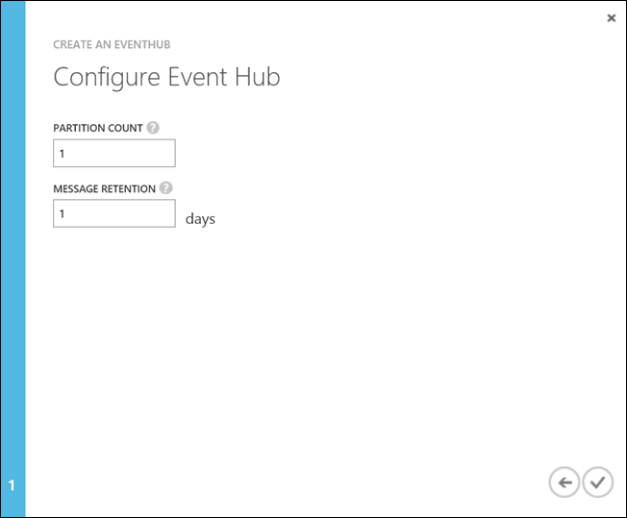
Notes:
Objective: This slide shows how to create an Azure Event Hub that will receive a stream of events.
Instructions:
For configuring the Event Hub, provide the right partition count and message retention values. For this demo we have used a partition count of 10 and a message retention value of 1. Make sure to note the partition count because we will need this value in the sender application.

Slide 21
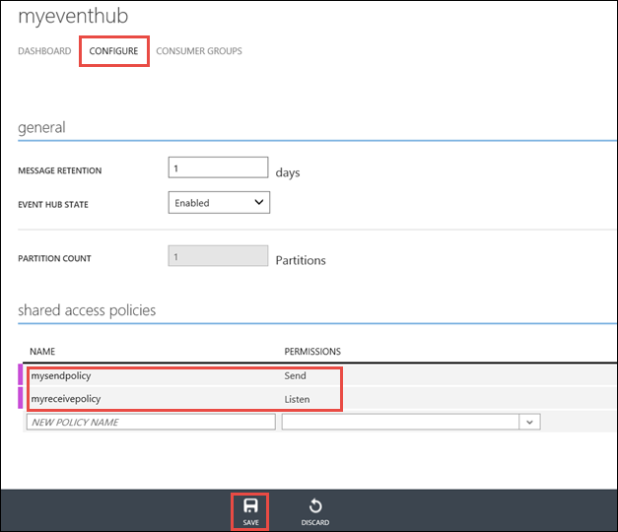
Notes:
Objective: This slide shows how to create an Azure Event Hub that will receive a stream of events.
Instructions: Now we need to configure the Event Hub by creating the two access policies for send and listen permission. After creating this, make sure to note the connection information from the bottom of the Dashboard to retrieve and save the connection strings for the Event Hub using the two policies.

Slide 22
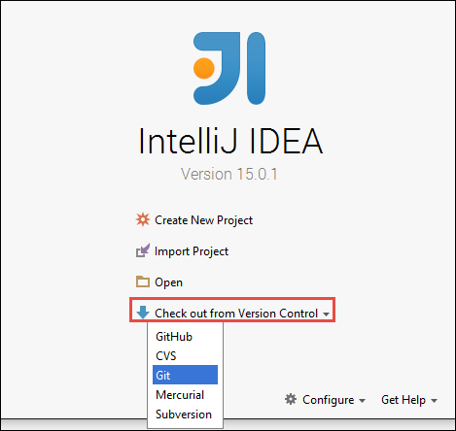
Notes:
Objective: This slide shows how to use a Scala application to send messages to Event Hub and then update the Scala streaming application for receiving the events.
Instructions:
In this part, we use a standalone local Scala application to send a stream of events to the Azure Event Hub that we created in the previous step. We will use a sample application that is available on GitHub at https://github.com/hdinsight/eventhubs-sample-event-producer. We will use this application to send messages to the Event Hub.
Open the application, EventhubsSampleEventProducer, in IntelliJ IDEA. From the Build menu, click Make Project. Create the output jar under \out\artifacts
Next, update the Scala streaming application for receiving the events. You can find a sample Scala application to receive the event and route it to different destinations at https://github.com/hdinsight/spark-streaming-data-persistence-examples.
For using this application, launch IntelliJ IDEA.
From the launch screen, select Check out from Version Control and then click Git.

Slide 23
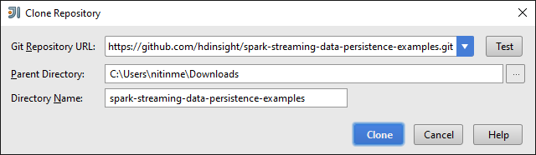
1
2
3
Notes:
Objective: This slide continues the demo showing how to use a Scala application to send messages to Event Hub and then update the Scala streaming application for receiving the events.
Instructions:
In the Clone Repository dialog box, provide the URL to the Git repository to clone from.
Specify the directory.
Click Clone.

Slide 24
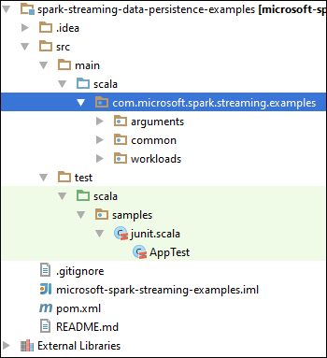
Notes:
Objective: This slide continues the demo showing how to use a Scala application to send messages to Event Hub and then update the Scala streaming application for receiving the events.
Instructions:
Open the Project View. It should resemble the view shown in the slide.

Slide 25
<scala.version>2.10.4</scala.version>
<scala.compat.version>2.10.4</scala.compat.version>
<scala.binary.version>2.10</scala.binary.version>
<spark.version>1.5.1</spark.version>
Notes:
Objective: This slide continues the demo showing how to use a Scala application to send messages to Event Hub and then update the Scala streaming application for receiving the events.
Instructions:
Next, open the pom.xml to ensure that the Spark version is correct.
Under node, look for the above code snippet and verify the Spark version.
Make sure the value for spark.version is set to 1.5.1.

Slide 26
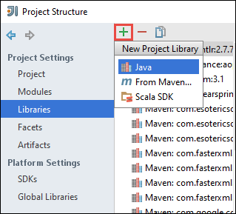
Notes:
Objective: This slide continues the demo showing how to use a Scala application to send messages to Event Hub and then update the Scala streaming application for receiving the events.
Instructions:
The application requires two dependency jars:
EventHub receiver jar. This is required for Spark to receive the messages from Event Hub. This jar is available on your Spark Linux cluster at /usr/hdp/current/spark-client/lib/spark-streaming-eventhubs-example-1.5.1.2.3.2.1-12-jar-with-dependencies.jar. You can use pscp to copy the jar to your local computer.
JDBC driver jar. This is required to write the messages received from Event Hub into an Azure SQL Database. You can download v4.1 or later of this jar file from Microsoft JDBC Driver for SQL Server - https://msdn.microsoft.com/en-us/sqlserver/aa937724.aspx
Next, add references to these jars in the project library.
Go to the IntelliJ IDEA window where you have the application, under the Project Structure, and then Libraries.
Click the add icon ( ), click Java, and then navigate to the location where you downloaded the EventHub receiver jar. Repeat the same step to add the JDBC jar as well to the project library.

Slide 27
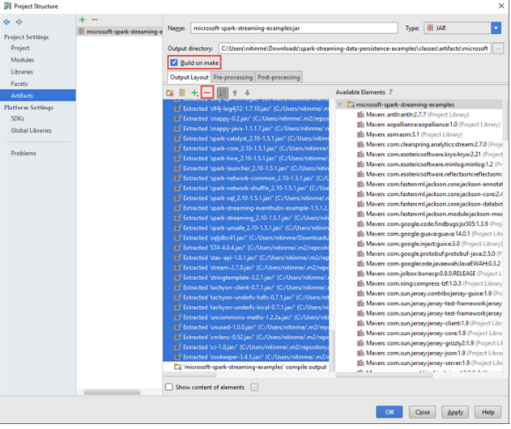
Notes:
Objective: This slide continues the demo showing how to use a Scala application to send messages to Event Hub and then update the Scala streaming application for receiving the events.
Instructions:
Now we need to create the output jar file.
In the Project Structure dialog box, click Artifacts and then click the plus symbol. From the pop-up dialog box, click JAR, and then click From modules with dependencies. Through the Create JAR from option, choose Select Main Class.
In the Create JAR from Modules dialog box, make sure that the option to extract to the target JAR is selected, and then click OK. This creates a single JAR with all dependencies.
The Output Layout tab lists all the jars that are included as part of the Maven project. You can select and delete the ones on which the Scala application has no direct dependency. For the application we are creating here, you can remove all but the last one (microsoft-spark-streaming-examples compile output) needs to be there. Select the jars to delete and then click the Delete icon ( ).
Make sure Build on make box is selected, which ensures that the jar is created every time the project is built or updated.

Slide 28
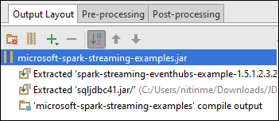
Notes:
Objective: This slide continues the demo showing how to use a Scala application to send messages to Event Hub and then update the Scala streaming application for receiving the events.
Instructions:
In the Output Layout tab, we need to add the dependency jar files.
Navigate to the Available Elements box to find the two dependency jars that you added earlier to the project library.
Add these to the Output Layout tab.
Right-click each jar file, and then click Extract Into Output Root.
Repeat this step for the other dependency jar as well. The Output Layout tab should now look like the screen shown on the slide.

Slide 29
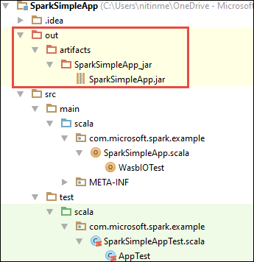
Notes:
Objective: This slide continues the demo showing how to use a Scala application to send messages to Event Hub and then update the Scala streaming application for receiving the events.
Instructions:
After this, we need to build, then Make Project. You can also click Build Artifacts to create the jar. The output jar is created under \out\artifacts.

Slide 30
java -cp EventhubsSampleEventProducer.jar com.microsoft.eventhubs.client.example.EventhubsClientDriver --eventhubs-namespace "mysbnamespace" --eventhubs-name "myeventhub" --policy-name "mysendpolicy" --policy-key "<policy key>" --message-length 32 --thread-count 32 --message-count -1
Notes:
Objective: This slide shows how to run the applications remotely on a Spark cluster using Livy.
Instructions:
After updating the Scala streaming application for receiving the events, run the applications remotely on a Spark cluster using Livy.
Using the command shown in this slide, start the local standalone application to generate events and send to Event Hub.
Copy the streaming jar (microsoft-spark-streaming-examples.jar) to the Azure Blob storage associated with the cluster. This makes the jar accessible to Livy. You can use AzCopy, a command line utility, to do this.
Use CURL to invoke the Livy endpoints to run the jobs remotely.

Slide 31
curl -k --user "admin:mypassword1!" -v -H "Content-Type: application/json" -X POST --data @C:\Temp\inputBlob.txt "https://mysparkcluster.azurehdinsight.net/livy/batches"
Notes:
Objective: This slide shows how to run the applications to receive the events into an Azure Storage Blob as text.
Instructions:
Open a command prompt and navigate to the directory where you installed CURL.
Using the command shown in this slide, replace the username/password and cluster name.

Slide 32
{ "file":"wasb:///example/jars/microsoft-spark-streaming-examples.jar", "className":"com.microsoft.spark.streaming.examples.workloads.EventhubsEventCount", "args":["--eventhubs-namespace", "mysbnamespace", "--eventhubs-name", "myeventhub", "--policy-name", "myreceivepolicy", "--policy-key", "<put-your-key-here>", "--consumer-group", "$default", "--partition-count", 10, "--batch-interval-in-seconds", 20, "--checkpoint-directory", "/EventCheckpoint", "--event-count-folder", "/EventCount/EventCount10"], "numExecutors":20, "executorMemory":"1G", "executorCores":1, "driverMemory":"2G" }
Notes:
Objective: This slide continues the demo showing how to run the applications to receive the events into an Azure Storage Blob as text.
Instructions:
The parameters in the file inputBlob.txt are defined as shown in the screenshot. Understand what the parameters in the input file are:
file is the path to the application jar file on the Azure storage account associated with the cluster.
className is the name of the class in the jar.
args is the list of arguments required by the class
numExecutors is the number of cores used by Spark to run the streaming application. This should always be at least twice the number of Event Hub partitions.
executorMemory, executorCores, and driverMemory are parameters used to assign required resources to the streaming application.

Slide 33
< HTTP/1.1 201 Created
< Content-Type: application/json; charset=UTF-8
< Location: /18
< Server: Microsoft-IIS/8.5
< X-Powered-By: ARR/2.5
< X-Powered-By: ASP.NET
< Date: Tue, 01 Dec 2015 05:39:10 GMT
< Content-Length: 37
<
{"id":1,"state":"starting","log":[]}* Connection #0 to host mysparkcluster.azurehdinsight.net left intact
Notes:
Objective: This slide continues the demo showing how to run the applications to receive the events into an Azure Storage Blob as text.
Instructions:
When you run the input command, you should see an output like what is shown on the slide.
Make a note of the batch ID in the last line of the output (in this example it is '1'). To verify that the application runs successfully, you can look at your Azure storage account associated with the cluster and you should see the /EventCount/EventCount10 folder created there. This folder should contain blobs that captures the number of events processed within the time period specified for the parameter batch-interval-in-seconds.

Slide 34
{ "file":"wasb:///example/jars/microsoft-spark-streaming-examples.jar", "className":"com.microsoft.spark.streaming.examples.workloads.EventhubsToAzureBlobAsJSON", "args":["--eventhubs-namespace", "mysbnamespace", "--eventhubs-name", "myeventhub", "--policy-name", "myreceivepolicy", "--policy-key", "<put-your-key-here>", "--consumer-group", "$default", "--partition-count", 10, "--batch-interval-in-seconds", 20, "--checkpoint-directory", "/EventCheckpoint", "--event-count-folder", "/EventCount/EventCount10", "--event-store-folder", "/EventStore10"], "numExecutors":20, "executorMemory":"1G", "executorCores":1, "driverMemory":"2G" }
Notes:
Objective: This slide shows you how to run the applications to receive the events into an Azure Storage Blob as JSON.
Instructions:
Open a command prompt, navigate to the directory where you installed CURL.
Run the following command (replace username/password and cluster name):
curl -k --user "admin:mypassword1!" -v -H "Content-Type: application/json" -X POST --data @C:\Temp\inputJSON.txt "https://mysparkcluster.azurehdinsight.net/livy/batches"
The parameters in the file inputJSON.txt are shown in above screenshot.
The parameters are similar to what you specified for the text output, in the previous step. Again, you do not need to create the output folders (EventCheckpoint, EventCount/EventCount10) that are used as parameters. The streaming application creates them for you.
After you run the command, take a look at your Azure storage account associated with the cluster. You should see the /EventStore10 folder created there. Open any file prefixed with part- and you should see the events processed in a JSON format.

Slide 35
{ "file":"wasb:///example/jars/microsoft-spark-streaming-examples.jar", "className":"com.microsoft.spark.streaming.examples.workloads.EventhubsToAzureSQLTable", "args":["--eventhubs-namespace", "mysbnamespace", "--eventhubs-name", "myeventhub", "--policy-name", "myreceivepolicy", "--policy-key", "<put-your-key-here>", "--consumer-group", "$default", "--partition-count", 10, "--batch-interval-in-seconds", 20, "--checkpoint-directory", "/EventCheckpoint", "--event-count-folder", "/EventCount/EventCount10", "--sql-server-fqdn", "<database-server-name>.database.windows.net", "--sql-database-name", "mysparkdatabase", "--database-username", "sparkdbadmin", "--database-password", "<put-password-here>", "--event-sql-table", "EventContent" ], "numExecutors":20, "executorMemory":"1G", "executorCores":1, "driverMemory":"2G" }
Notes:
Objective: This slide shows you how to run the applications to receive the events into an Azure SQL Database table.
Instructions:
Before running this step, make sure you have an Azure SQL Database created. You will need values for database name, database server name, and the database administrator credentials as parameters. However, you don’t need to create the database table, as the streaming application creates that for you.
Open a command prompt, navigate to the directory where you installed CURL, and run the command:
curl -k --user "admin:mypassword1!" -v -H "Content-Type: application/json" -X POST --data @C:\Temp\inputSQL.txt "https://mysparkcluster.azurehdinsight.net/livy/batches"
Next, provide the parameters in the file inputSQL.txt are defined as shown in the above screenshot.

Slide 36
00046b0f-2552-4980-9c3f-8bba5647c8ee
000b7530-12f9-4081-8e19-90acd26f9c0c
000bc521-9c1b-4a42-ab08-dc1893b83f3b
00123a2a-e00d-496a-9104-108920955718
0017c68f-7a4e-452d-97ad-5cb1fe5ba81b
001KsmqL2gfu5ZcuQuTqTxQvVyGCqPp9
001vIZgOStka4DXtud0e3tX7XbfMnZrN
00220586-3e1a-4d2d-a89b-05c5892e541a
0029e309-9e54-4e1b-84be-cd04e6fce5ec
003333cf-874f-4045-9da3-9f98c2b4ea49
0043c07e-8d73-420a-9af7-1fcb94575356
004a11a9-0c2c-4bc0-a7d5-2e0ebd947ab9
Notes:
Objective: This slide continues the demo showing how to run the applications to receive the events into an Azure SQL Database table.
Instructions:
To verify that the application runs successfully, connect to the Azure SQL Database using SQL Server Management Studio.
Once you are connected to the database, navigate to the EventContent table that was created by the streaming application and then run the Select statement. You should see the output similar to what’s shown in the slide.

Slide 37

© 2016 Microsoft Corporation. All rights reserved. Microsoft, Windows, Windows Vista and other product names are or may be registered trademarks and/or trademarks in the U.S. and/or other countries.
The information herein is for informational purposes only and represents the current view of Microsoft Corporation as of the date of this presentation. Because Microsoft must respond to changing market conditions, it should not be interpreted to be a commitment on the part of Microsoft, and Microsoft cannot guarantee the accuracy of any information provided after the date of this presentation. MICROSOFT MAKES NO WARRANTIES, EXPRESS, IMPLIED OR STATUTORY, AS TO THE INFORMATION IN THIS PRESENTATION.

